Slide 1
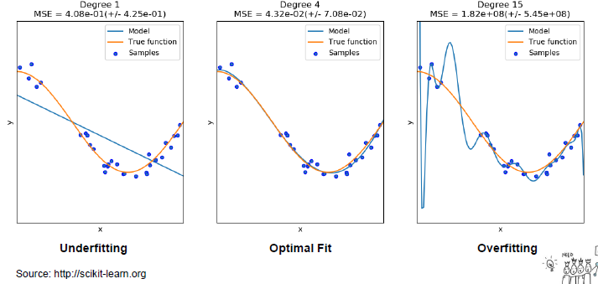
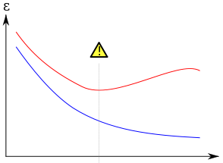
Error measurement – what is overfitting?
Split data into 3 parts:
Training sample – for fitting model
Validation sample – for model selection
Test sample – for final model results showing
1
2
3
Error
Validation sample error Training sample error
Optimal fit
Underfitting
Overfitting
Model complexity

